Slide 1

Introduction to International Arbitration
A Public Lecture Delivered at the Faculty of Law,
Baze University, Abuja, on 6th July 2026.
  Onyekachi Umah, FCIArb(UK)
Director, SabiLaw Academy
www.Academy.SabiLaw.org
www.SabiLaw.org

Slide 2

Introduction to International Arbitration
Introduction & Expectations
What is NOT Arbitration?
What is Arbitration?
What is International Arbitration?
Legal Framework
Relevant Procedural Laws
Relevant Procedural Rules
Conducting and Participating in Arbitration
Award Writing
Awards v. Procedural Orders
Requirements of an Enforceable Award
Enforcement & Setting Aside
Emerging Issues

Slide 3
Introduction & Expectations
Who are you?
Deliverables

Slide 4
What is NOT Arbitration?
What is ADR?
ADR Contours
Negotiation
Mediation
Conciliation
Expert Determination
Arbitration V. ADR

Slide 5
What is Arbitration?
Arbitration
History
AdHoc & Institutional Arbitration
Arbitration Agreement
Parties
Process
Outcome

Slide 6
What is International Arbitration?
Different Places of Business
Seat of Arbitration outside places of business
Performance outside places of business
Agreement of Parties

Slide 7
Legal Framework for a Final Award
Lex Arbitri/Procedural Law/Curial Law (guides arbitral proceeding)
Procedural Rule (guides arbitral proceedings)
Lex Loci Arbitri/Applicable Law/Governing Law/Proper Law/Substantive Law (applies to substantive matters in issue, often national laws, international trade law, modern law merchant [lex mercatorial] and a blend of national and public international law.
Ex aequo et bono (fair and equitable principle applies to substantive matters, where parties agree)

Slide 8
Relevant Laws
The Arbitration and Mediation Act 2023 and its Rules (Municipal)
The various States Arbitration Laws and their Rules (Municipal)
Various national laws on arbitration by countries of the world and their rules (International)
The International Trade Law, and Modern Law Merchant [Lex Mercatorial]
The Geneva Protocol 1923
The Geneva Convention 1927
The New York Convention 1958 (International)
The International Center for Settlement of Investment Treaties (ICSID Convention) 1965
UNCITRAL Model Law
UNCITRAL Arbitration Rules and other Institutional Rules
Adhoc Rules

Slide 9
Relevant Rules (1/2)
The Arbitration and Mediation Act (AM Act) Arbitration Rules 2023
UNCITRAL Arbitration Rules
The Regional Center for International Commercial Arbitration Lagos (RCICAL) Arbitration Rules 2019
The Lagos Arbitration Court (LCA) Arbitration Rules 2018
The CIArb Arbitration Rules 2015
The ICC Arbitration Rules 2021
The SIAC Arbitration Rules 2016

Slide 10
Relevant Rules (2/2)
The LCIA Arbitration Rules 2014
The AAA-ICDR Arbitration Rules 2021
The HKIAC Administered Arbitration Rules
The Construction Industry Model Arbitration Rules 2011
The NAI Arbitration Rules 2015
The SCC Arbitration Rules

Slide 11
Conducting/Participating in Arbitration
Appointments & Constitution of Panel
Preliminary Hearing (Agreement, Law, Rules, Seat, Venue, Timetable)
Procedural Orders
Interim Awards & Bifurcation
Points of Claim, Points of Defence and Counterclaim & Replies
Pre-Hearing Review
Evidential Hearing
Post-Hearing Submissions
Final Award
Enforcement and Setting Aside

Slide 12
Award Writing
The Agreement to Arbitrate (Art. 5 New York Convention, Art. 35 Model Law)
The Need for a Dispute
The Commencement of Arbitration
The Arbitral Proceedings
The Decision of the Tribunal
The Enforcement of Award

Slide 13
Awards v Procedural Orders
Mere decisions on procedures
Not subject to annulment
Not subject to recognition and enforcement

Slide 14
Requirements of An Enforceable Award
Content
Conditions for Setting Aside
Conditions for challenging Recognition and Enforcement

Slide 15
Enforcement & Setting Aside of Award (1/2)
SabiLaw’s Mnemoic for Grounds for Enforcement & Setting Aside
CDSPBAP (Counsel Demanded Some Payment Before Award Publishing)
Parties Provable Conditions
Court-Initiable Conditions

Slide 16
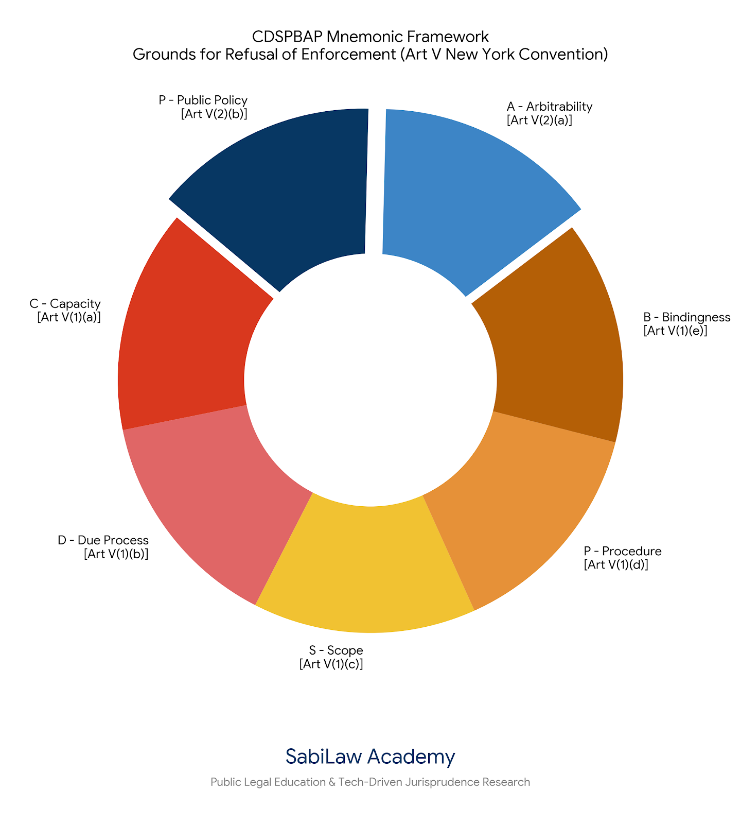

Slide 17
Enforcement & Setting Aside of Award (2/2)
SabiLaw’s CDSPBAP (Counsel Demanded Some Payment Before Award Publishing)
C – Capacity [Art V(1)(a) / Sec 58(2)(a)(i)] = The unmasking and corporate authority hurdle.
D – Due Process [Art V(1)(b) / Sec 58(2)(a)(ii)] = The algorithmic block-time notice battle.
S – Scope [Art V(1)(c) / Sec 58(2)(a)(iii)] = Ensuring the automated reference didn't exceed party consent.
P – Procedure [Art V(1)(d) / Sec 58(2)(a)(v)] = Testing token-weighted crowdsourced juror mechanisms.
B – Bindingness [Art V(1)(e) / Sec 58(2)(a)(vi)] = Assessing if a seatless, virtual award has reached operational finality.
A – Arbitrability [Art V(2)(a) / Sec 58(2)(b)(i)] = Arbitrating cryptocurrency and crypto-assets contrary to the Investment and Securities Act 2025
P – Public Policy [Art V(2)(b) / Sec 58(2)(b)(ii)] = The conflict with regulated activities conducted unregulated on unregulated digital platforms

Slide 18
Emerging Issues
Third-Party Funding
Blockchain Arbitration
Artificial Intelligence (AI) Arbitration
Online Arbitration

Slide 19
THANK YOU!
Questions
Answers
www.Academy.SabiLaw.org
www.SabiLaw.org

Slide 20

www.Academy.SabiLaw.org
www.SabiLaw.org

Slide 21


Slide 22


